Slide 1
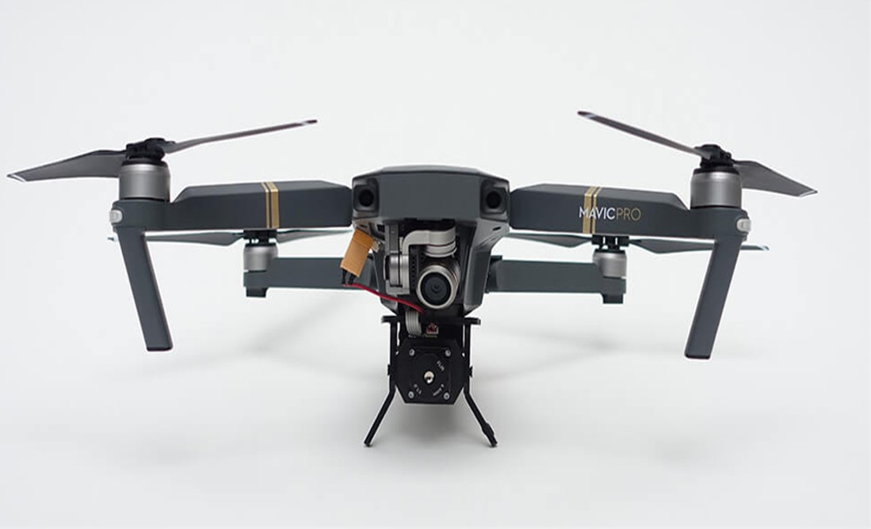
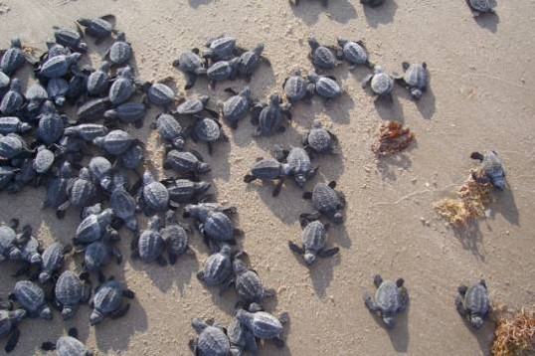
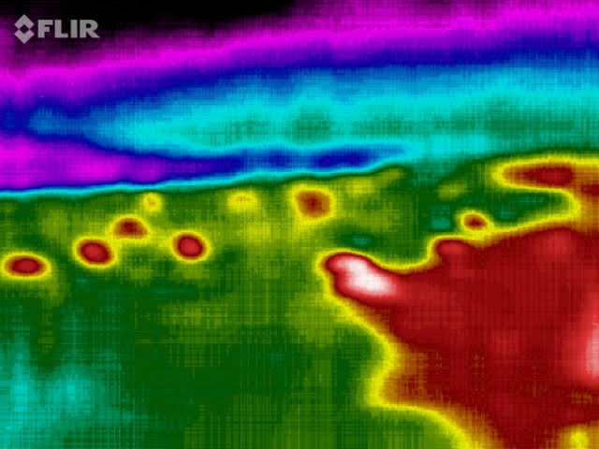
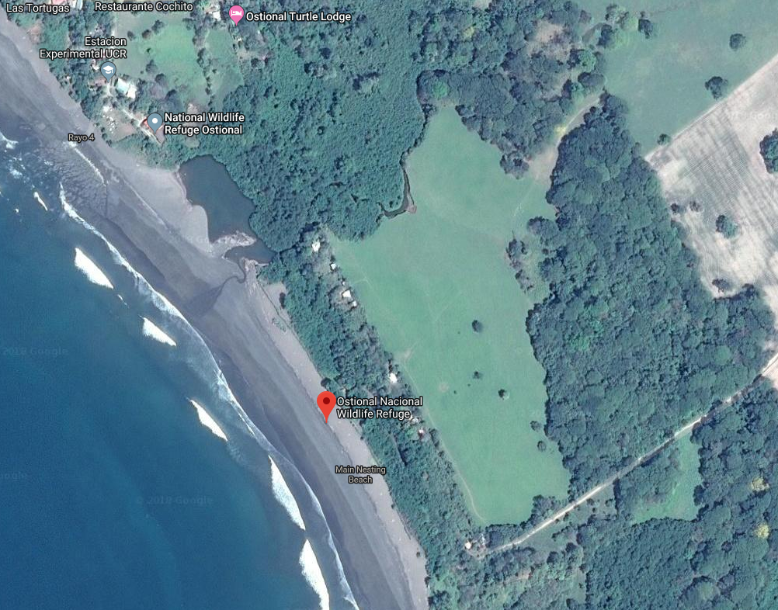
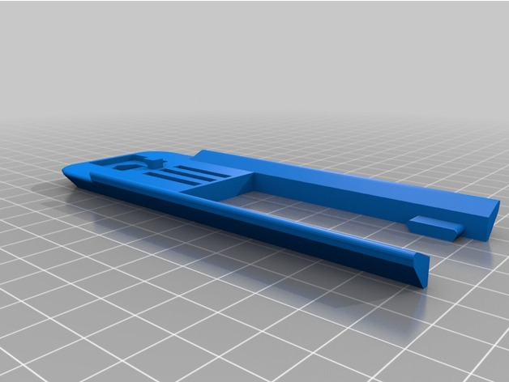
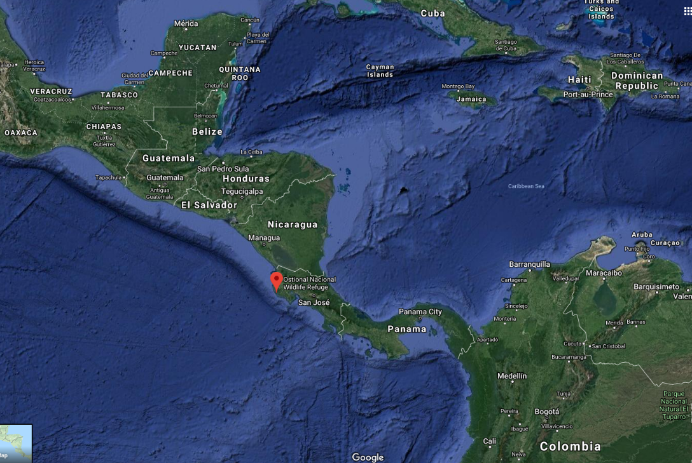
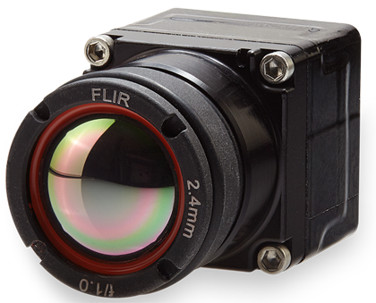
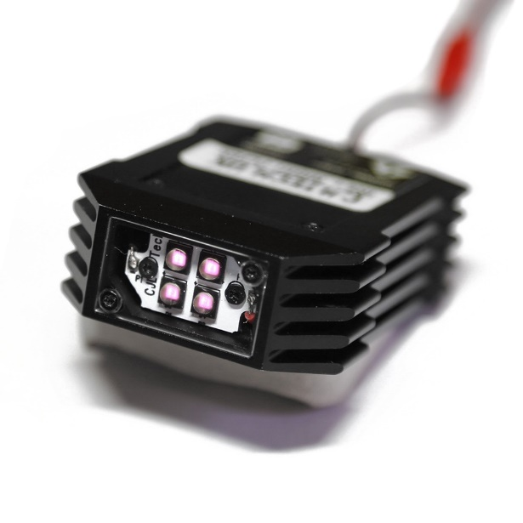
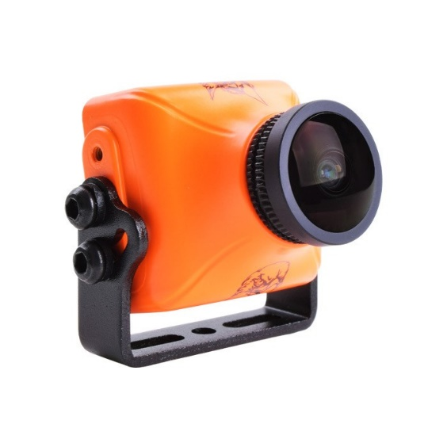
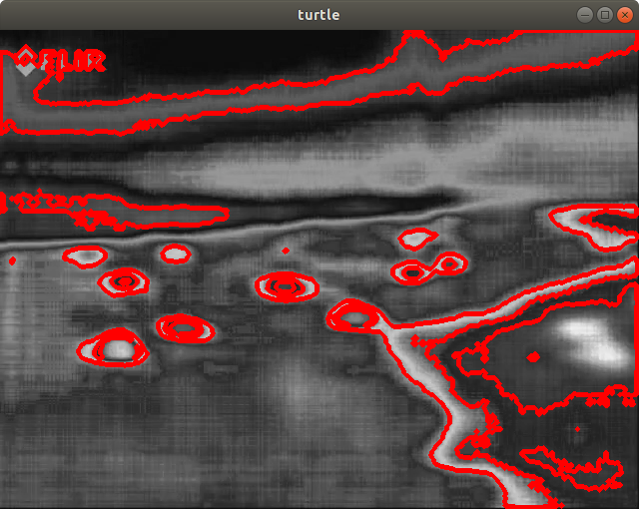
Affordable Unmanned Aerial Systems, sensors, modular payloads, and algorithmic tools for ecological study
S Nemani, C Edwards, M Hall, W Martin, and D Evangelista (evangeli@usna.edu)
Department of Weapons, Robotics, and Control Engineering, United States Naval Academy
Abstract: Ecological and conservation efforts are often complicated by the need to gather data in remote or inaccessible areas in unideal conditions. Researchers often cite the size, behavior or location of such populations as a major impediment to their population surveys. In military missions, unmanned aerial systems (UAS) have been instrumental in providing remote access and persistent presence. We will discuss an on-going design effort to develop affordable UAS designs, as well as sensors and modular payloads, aimed at supporting science and military missions.
Methods and Materials
Fly sensors (payloads) over target area of interest
Analyze imagery using machine vision methods
Visible light (4K, GoPro)
Thermal / IR (FLIR)
Active IR (mod GoPro/Runcam w/emitter)
Additional counts for ground truth
Collect additional environmental data (weather, wind and water, illumination, white balance, nav aids for registration)
Modular Payloads
Fixed wing (Flitetest derivative) spare also under development
Deployment: March 2019
Planned field testing in Maryland, followed by deployment to Costa Rica in March 2019 to film olive Ridley arribada
Ostional, Costa Rica
Obtain aerial imagery of sea turtles nesting
Third quarter lunar phase
Local field testing to develop training set for automatic turtle detection and counting.
Inflatable sea turtle training shapes (Intex Co; Long Beach, CA).
DJI Mavic (1.62lb)
Gimballed 4K
source: https://rectrixdrones.com/
FLIR Boson
source: https://www.thingiverse.com/thing:1997900
3D printed base mount for Mavic
FLIR Boson (7.5g, 4.9cm³)
source http://www.seaturtleinc.org/wp-content/uploads/2012/05/a9273edbc93df5f187263d5bde98907d-wpcf_190x126.jpg
Thermal image of olive Ridley sea turtles (Lepidochelys olivacea), photo V Bezy
source: https://groupgets-files.s3.amazonaws.com/boson/Boson_2.4mm_f1.0_faceleft-small.png
Using UAS and machine vision to get accurate counts
Governments and conservation authorities rely on accurate population surveys to regulate and inform policy.
Population counts are generally obtained through sampling or estimation, since it is very difficult to get eyes on every member of a population.
Manual counting is laborious and time intensive; may require subsampling along transects and application of other estimation techniques.
Can UAS with modular payloads and machine vision techniques help?
while 1
capture image from video
convert to grayscale
threshold to segment targets
find moments >1000 and <2000
select contours of proper size
end
Satellite Images of Ostional Wildlife Refuge, Main Nesting Beach, Costa Rica. Source: Google Maps
CJLTech IR4+ emitter and Runcam camera
source: getfpv.com
Acknowledgements: We thank Dr V Bezy, UNC; CAPT M Hurni, USN; CAPT T Robertson, USN; ENS C Garcia, USN. We also thank the USNA ES281C “School of Drones” Fall 2018 class and Prof M Schroeder / USNA Research. Sponsors are Lockheed Martin and USNA.
Blob Detection Pseudocode
OpenCV is an open source software library for computer vision in Python or C++
Blob Detection
Shape (moments)
Color or brightness
Machine Learning
Haar Cascade w training, validation sets
Register and combine multi-spectral
References
[1] Bézy, V.S., Girondot, M., and R.A. Valverde. 2016. A new method for estimating nest density at an arribada rookery in Ostional, Costa Rica. Journal of Herpetology. doi: 10.1670/14-152.
[2] Sykora-Bodie, S. T., Bezy, V., Johnston, D. W., Newton, E. and Lohmann, K. J. (2017). Quantifying nearshore sea turtle densities: applications of unmanned aerial systems for population assessments. Scientific Reports 7, 17690. doi:10.1038/s41598-017-17719-x.
Thermal image processed with blob detection

